Slide 1
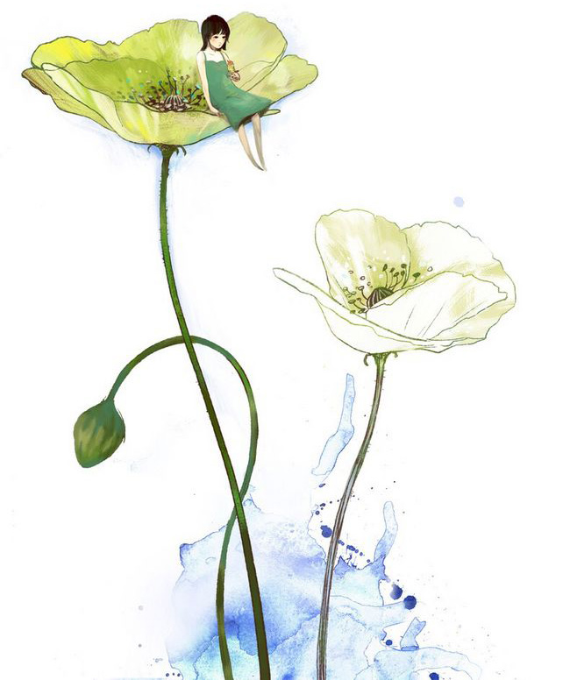
The Interview
Group Member：
容逸朗 Related Background
龙锐 Text Organization
王卓 Language points, sentences
张晨阳 Language points, sentences

Slide 2
Contents
Part I
Part II
Part III
Background
Text Organization
Language Points & difficult sentences

Slide 3
Background
Part I

Slide 4
Part I
Background
Introduction
The interview is written about a black man's experience when he is discharged after serving in the British military at the end of a war.
The author does not reveal that the soldier is a minority until near the end of the story. By doing this the author emphasizes the unfairness in how the man was treated.
(Selected bibliography: "To Sir, With Love")
To Sir, With Love (1959)

Slide 5
Part I
Background
Author
Eustace Edward Ricardo Braithwaite
(June 27, 1912 – December 12, 2016)
publishing as E. R. Braithwaite.
Guyanese-born British-American novelist, writer, teacher and diplomat.
Best known for his stories of social conditions and racial discrimination against black people.
E. R. Braithwaithe

Slide 6
Text Organization
Part II

Slide 7
Part II
Text Organization
Part1
Part2
Part3
the background after the demobilization
the interview
the feeling after rejection

Slide 8
Part II
Text Organization
1
The background after the demobilization
Industry was reorganizing itself for post-war production.
The urgent demand for qualified technologists, especially in the field of electronics, which was his special interest.
He has two years of working experience as a Communication Engineer, earning enough to pay for postgraduate study in England.
1
2
3
4
He studied to keep up with new trends and developments.
Braithwaite has a science degree and varied experience in engineering technology.
Interview invitation letters from three companies

Slide 9




Part II
Text Organization
2
The interview
1
the author had taken great care with his appearance.
the experience with the receptionist.
She was very enthusiastic before learning that the author was coming for an interview. After that, she maintained a silent hostility.
2
3
During the interview, he answered the thorough questions perfectly.
4
Mr. Symonds refused to offer a job because of his black skin.

Slide 10



Part II
Text Organization
3
Reaction after rejection
He felt drained of strength
and thought.
The fact made him recall his
six years of service in the war.
Black skin made him feel
violently sick.

Slide 11
Language Points ＆
difficult sentences
Part III

Slide 12
Part III
Words
round :
[n]. 阶段；轮次；回合；常规活动；圆，圆形物；循环；固定路线
the usual round of ...（常规的……流程）
She was knocked out of the championship in the third round.
digs :
[n.] 挖；寓所；住所；嘲讽（dig的复数）
[v.] to search for an object or information. 挖掘；摸索（dig的三单形式）
…I had settled myself in "digs" and …
courteous:
[adj.] Polite and showing respect. 有礼貌的；谦恭的
Although she often disagreed with me, she was always courteous.

Slide 13
Part III
Words
promptly :
[adv.] quickly, without delay. 迅速地；立即地；敏捷地
We try to answer readers' letters as promptly as we can.
reason :
[n.] the cause of an event or situation 理由；理性；动机
[vi.] to make judgments based on practical facts 推论；劝说
[vt.] 说服；推论；辩论
Anyway, I reasoned, this is unfair for me. (我觉得)
polish:
[v.] 抛光，擦亮；修改，润色；(使)完美，改进
[n.] 磨光，擦亮；擦亮剂；打磨光滑的面；完美，娴熟；优雅，精良
My shoes were smartly polished.

Slide 14
Part III
Words
wear :
[v.] 穿，戴；蓄(发,须)；面露；耗损，耐用；接受(尤指不赞成的事物)；(船)升(旗)；(诗、文)消磨(时间) ；(使)船头转向(下风)
[n.] 衣物；磨损；耐久性
She is wearing a simple black dress. I was wearing my best smile.
I'd ask my boss for some time off but I don't think she'd wear it.
disapproval :
[n.] the feeling of having a negative opinion of sb. or sth.. 不赞成；不喜欢；不以为然
There was a note of disapproval in the teacher's voice.
echo:
[vt.] to repeat. 反射；重复
[vi.] 随声附和；发出回声
[n.] a sound that is heard after it has been reflected. 回音；效仿
The echoes of his scream sounded in the cave for several seconds.

Slide 15
Part III
Phrases
on learning that :
了解到
On learning that there were no buses, they decided to go to the early performances.
make a point of doing sth. :
强调；决心；认为；重视做(某事)
Perhaps a lot of them don't realize how well we are doing, because we don't make a point of publicizing.

Slide 16
Part III
Phrases
work as :
担任；以…身份而工作
I explained that after graduating I had worked for two years as a Communication Engineer.
on top of the world :
幸福到极点；欣喜若狂；世界最高点
I'm on top of the world. I never expected to do so well.

Slide 17
Part III
Phrases
be associated with :
Problems or dangers associated with a particular thing or action
和…联系在一起；与……有关，与……有关系
He no longer wished to be associated with the past company.
hold down :
To keep something 抑制；压制；保有(工作等)；胜任而保持(职位等)
I felt quite confident of my ability to hold down a good job.

Slide 18
Part III
Sentences
I had been very much encouraged by this, as I had made a point of keeping up with new trends and developments by borrowing books through the Central Library System, and by subscribing to various technical journals and magazines, so I felt quite confident of my ability to hold down a good job.

Slide 19
Part III
Sentences
She set off down a wide corridor, her back straight and stiff with a disapproval which was echoed in the tap-tap of her high heels. At the end of the corridor we entered an automatic lift; the girl maintained a silent hostility and avoided looking at me..

Slide 20
Part III
Words
deliberate:
[adj.] intentional or planned 故意的，存心的；从容不迫的
a deliberate act of vandalism
She spoke in a slow and deliberate way.
[v.] to think or talk sth. seriously and carefully 深思熟虑，反复思考
The jury deliberated for five days before finding him guilty.
take time to deliberate 做事要深思熟虑
deliberate on 审议；仔细研究，考虑
abundantly:
[adv.] more than enough 丰富的，大量的
Calcium is found most abundantly in milk.
She made her wishes abundantly clear. (~ clear 十分清楚；非常明白)

Slide 21
Part III
Words
dismissal:
[n.] an employer makes sb. leave their job 解雇；开除；不予考虑；不予理会
Her casual dismissal of the threats seemed irresponsible.
the dismissal of the appeal 驳回上诉
navigate:
[v.] to direct the way that a ship, aircraft, etc. 导航；航行
How do you navigate your way through a forest？
The river became too narrow and shallow to navigate.
We next had to navigate a complex network of committees. （找到正确方法）

Slide 22
Part III
Words
sunlit:
[adj.] receiving a lot of light from the sun 阳光照耀的
sunlit streets
squadron:
[n.] a unit of one of the armed forces 中队
a bomber/fighter squadron 轰炸机╱战斗机中队
absurdity:
[n.] stupid and unreasonable 荒谬；荒唐
Duncan laughed at the absurdity of the situation.

Slide 23
Part III
Words
prejudice:
[n.] an unfair and unreasonable opinion 偏见；成见
a victim of racial prejudice
Their decision was based on ignorance and prejudice.
[v.] 使怀有偏见（~sb. against sb./sth.）;损害
The prosecution lawyers have been trying to prejudice the jury against her.
kit:
[n.] a set of things, such as tools or clothes. 配套元件；成套工具；全套衣服及装备
[v.] kit sb. 'out/'up (in/with sth.)使某人装备起来
They were all kitted out in brand-new ski outfits.

Slide 24
Part III
Words
glorious:
[adj.] beautiful/ hot and sunny weather 光荣的；壮丽的；极为宜人的；阳关灿烂的
a glorious chapter in our country's history
a glorious sunset
a glorious trip to Rome
undying:
[adj.] permanent and never end 永恒的；不朽的
undying love

Slide 25
Part III
Words
hold one’s own:
坚守，保持力量
He held his own in the contest and finished in the first place. (坚守)
The patient is holding her own. (坚持住)
be suited to/for sth./sb.：
适宜于
The gestures of the body must be suited to the discourse you are upon.
be suitable for/to sb./sth.:
适合，符合要求
The application must be suitable for use in the home environment.

Slide 26
Part III
Phrases
have sb./sth. in mind (for sth.):
考虑，想到
We always had in mind for whom we were making the film.
I could see he was not telling me all he had in mind.
drain sb./sth. of sth.:
使耗尽，使精疲力竭
His face was drained of color. (显得精疲力尽)
The country was drained of its manpower and wealth by war. (使耗尽)

Slide 27
Part III
Sentences
Employing you would mean placing you in a position of authority over a number of our English employees, many of whom have been with us a very long time, and we feel that such an appointment would unfavorably affect the balance of good relationship which has always obtained in this firm.

Slide 28
Part III
Sentences
I was an airman in flying kit while on His Majesty’s business, smiled at, encouraged, welcomed by grateful civilians in bars or on the street, who saw not me, but the uniform and its relationship to the glorious, undying Few.
the glorious, undying Few (少数永远光荣的人)
“The stamina and valour of our fighter pilots remained unconquerable and supreme. Thus Britain was saved. Well might I say in the House of Commons(英国下议院), 'Never in the field of human conflict was so much owed by so many to so few."

Slide 29

Thanks

